Slide 1
What will it take for the HIS to generate accurate information for severe malaria and malaria mortality?
Hellen Gatakaa
PMI Measure Malaria, December 12, 2022

Slide 2
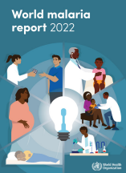
Background
Estimated 247 million malaria cases; 619,000 deaths in 2021
15 deaths per 100,000 population at risk (malaria mortality rate); 58 in the African region
Estimates depend on the quality of surveillance systems and availability of data over time
A new method in 2021 → higher estimates for malaria deaths in children aged <5 years; CoD fraction from 4.8% to 7.8% for 2019

Slide 3
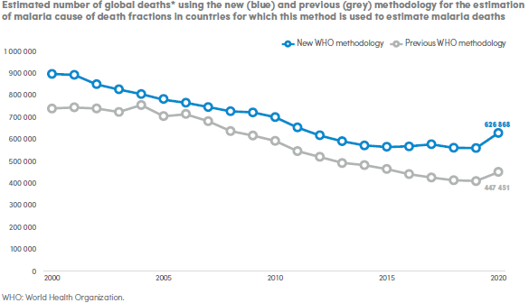
Background

Slide 4
Availability of inpatient malaria data
Malaria routine data, in electronic form, is mostly limited to outpatient data
Inpatient registers are available, but data is aggregated to inform service workload
Gaps observed in data extracted from the registers (for studies), for example:
Likely misclassification of some cases if system isn’t designed to capture all characteristics of severe malaria (Akech et al., 2020)
Probable overestimate of malaria deaths when diagnosis is based on malaria rapid diagnostic test (Fitzgerald et al., 2018)
Cause of death not accurately reported (Fitzgerald et al., 2018;Mremi et al., 2018)
Inadequate systems to capture accurate cause of death data at community level

Slide 5
Availability of inpatient malaria data
Local demographic surveillance systems (linked community and health facility data)
Established hospital surveillance in select sentinel sites, some hosted on DHIS2 (e.g., program in six hospitals by the Uganda’s malaria surveillance project)
Use of DHIS2 tracker module for case-based data; however:
Can it be deployed at national scale?
Does is it have capabilities for integrated (all disease) data, both morbidity and mortality?
Any guidance on server capacity?
Are there challenges with upload and download speeds? What ICT infrastructure is needed for optimum performance?
Notes:
DHIS2 is not a full fledged EMR system that can connect various services received by a patient in a hospital (registration, billing, OPD, IPD, drugs and laboratory)
OpenMRS is not designed to be an HMIS or very suitable to support primary health care–based applications

Slide 6
Challenges observed
Aggregate data most common but lacks disaggregation capabilities and is prone to inaccuracies
Required data elements are captured at different points in the patient flow
System designs without a good understanding of severe malaria case management
Challenges with upload and download speeds in DHIS2 tracker
Suboptimal data quality, including on use of disease classification and certification of cause of death
Data analytics and visualization within HIS platforms

Slide 7
What will it take to generate accurate data?
Do countries measure and monitor indicators of severe malaria?
What investments are available for HMIS and health worker capacity in classification of diseases and certification of cause of death?
Are there guidelines for design of the applications?
Are EMR and HMIS interoperable?

